Slide 1

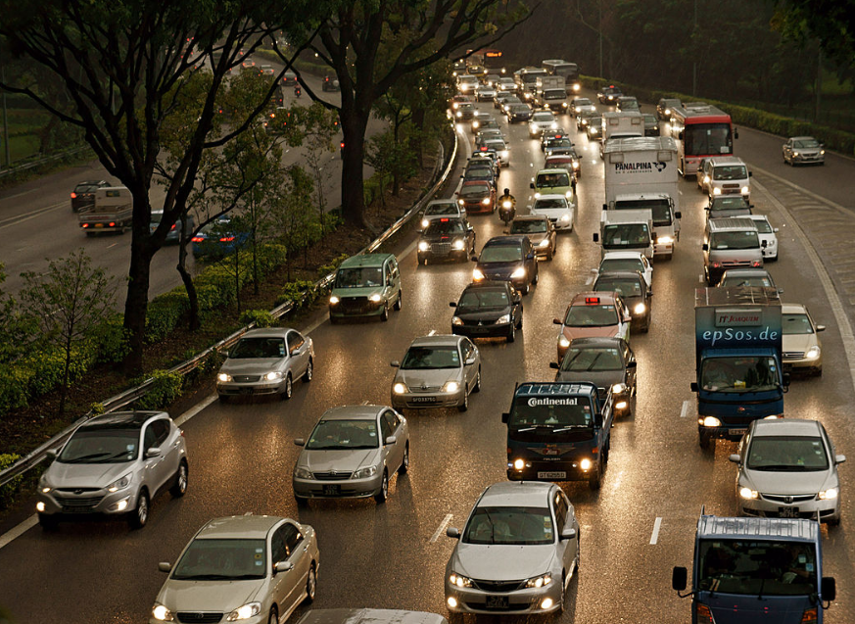
Hack-O-Mania’25
AI-Based Traffic Optimization and Smart Navigation
Enhancing Urban Mobility Through AI
Presented By- PIXEL GROUP
Tushar Yadav
Ayush Khanna
Mohik
Vanshul
Abhay

Slide 2




Problem Statement
Time Wasted
Economic Impact
Inefficient Systems
INIDAN drivers wasted 110 hours in traffic in 2024.
Congestion costs ₹1.47 lakh crore annually.
Existing traffic management
remains static and
outdated.
Traffic not only reduces efficiency but also increases frustration and stress levels, leading to mental and physical health issues.
Additionally, businesses suffer as employees arrive late, deliveries are delayed, and overall economic growth is hindered.

Slide 3
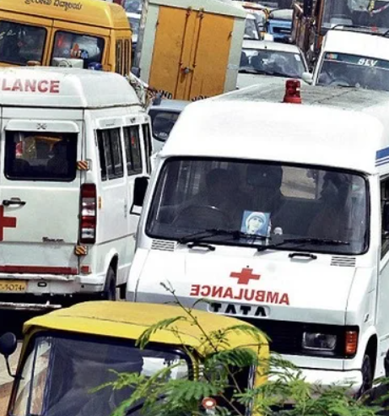

A large number of patients in India die due to relentless delay in medical care caused by traffic jams and ill-equipped ambulances.
According to the Ministry of Road Transport and Highways’ data every day about 24,012 patients die due to delays caused by traffic related issues.

Slide 4
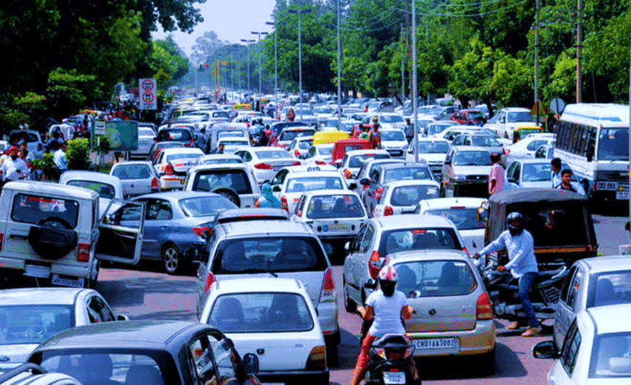
1. Real-Time Traffic Analysis
AI models can detect traffic density at intersections using cameras and sensors.
The system can analyze congestion levels and adjust traffic light durations dynamically, reducing wait times.
2. Adaptive Traffic Signal Control
Instead of fixed light cycles, AI can optimize signal timing based on real-time traffic conditions.
3. Emergency Vehicle Prioritization
AI can detect emergency vehicles (ambulances, fire trucks, police) and adjust signals to give them a clear route.
4. Reducing Fuel Consumption
less idle time means lower fuel consumption, leading to cost savings for drivers and less pollution.

Slide 5





Proposed Solution (Overview)
AI-driven Optimization
Real-time Adaptation
Improved Flow
Reinforcement Learning powers traffic signal timing.
System adjusts to changing traffic conditions instantly.
Reduces congestion across the urban network.

Slide 6








AI-Driven Traffic Signal Optimization
Optimized Results
40% reduction in wait times in Pittsburgh
Dynamic Adjustments
Adapts to traffic patterns and incidents
Real-time Data Input
Sensors, cameras, connected vehicles
Reinforcement Learning
AI learns optimal signal timings

Slide 7
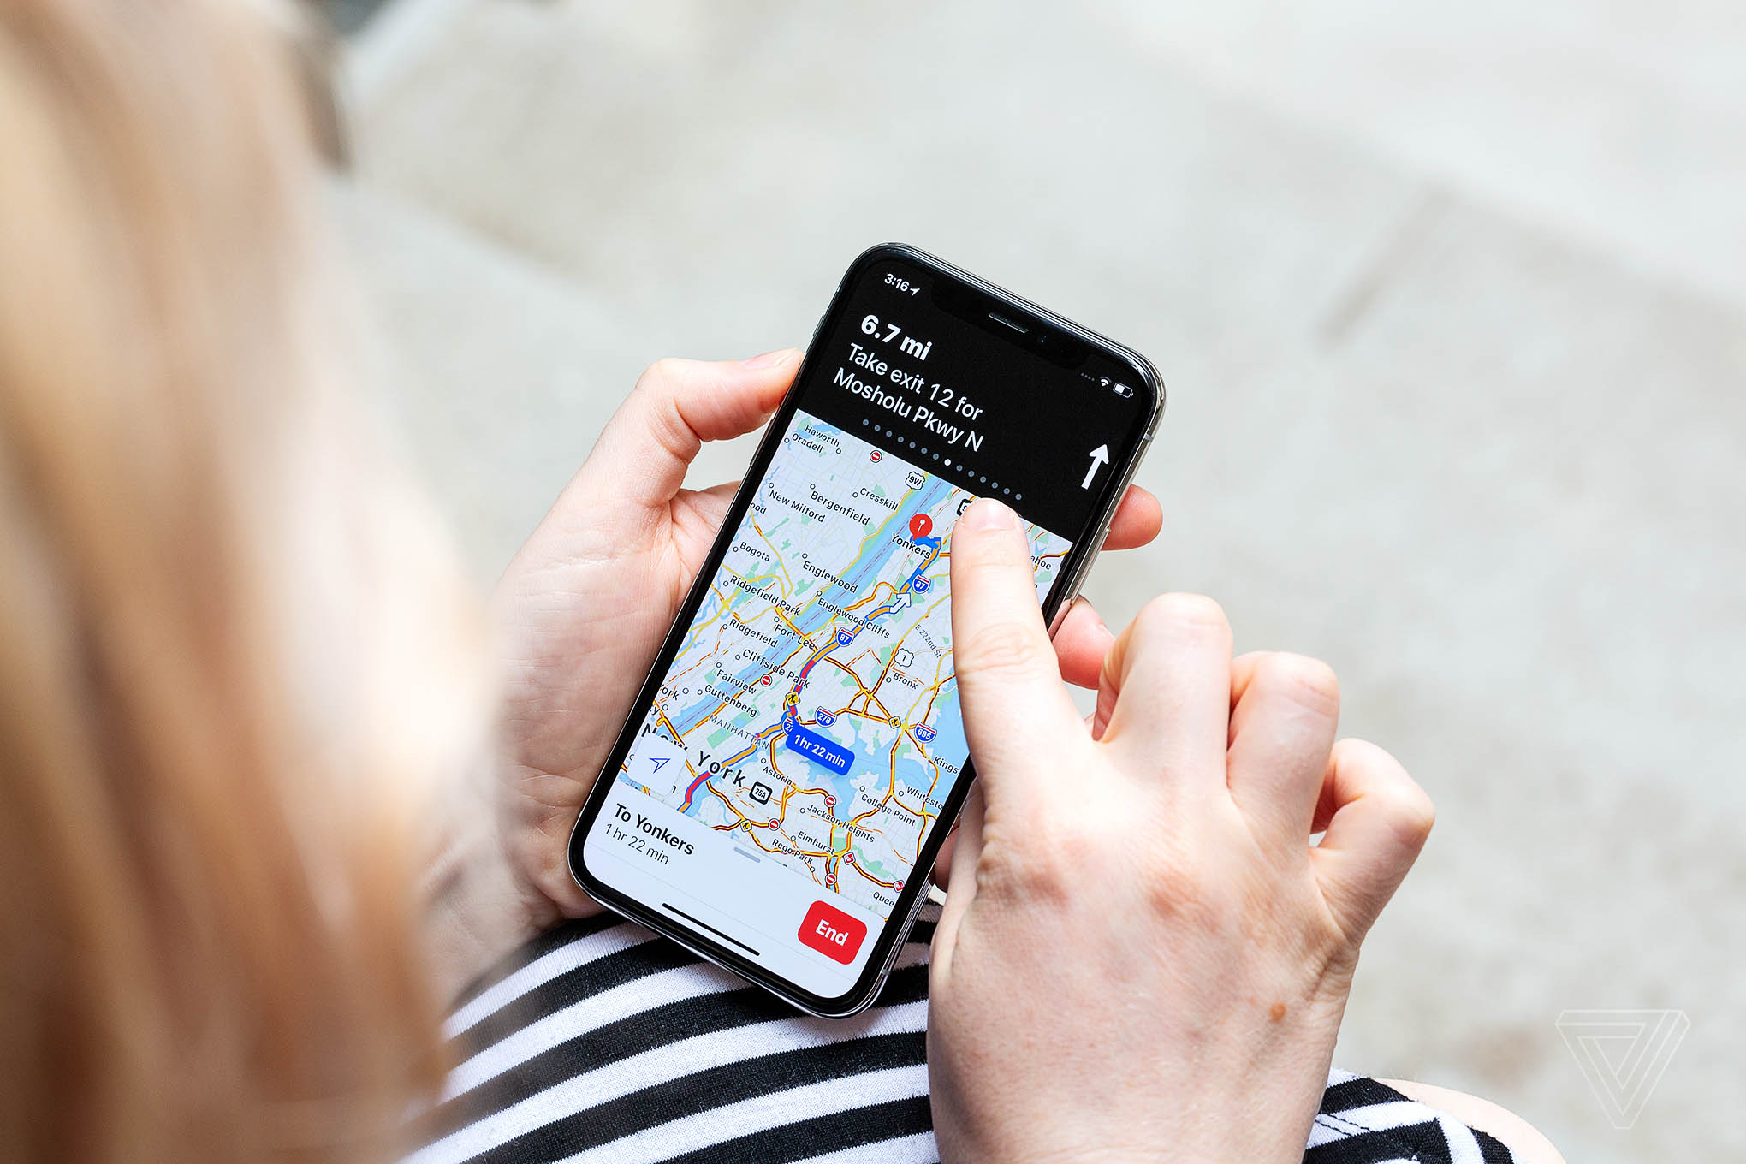
Smart Navigation System
AI-powered Route Planning
Algorithms consider real-time traffic conditions to suggest optimal routes.
Predictive Analysis
System anticipates congestion hotspots before they form.
Personalized Recommendations
Users receive custom routes based on preferences and conditions.
App Integration
Seamless collaboration with Google Maps, Waze, and others.

Slide 8








Key Benefits
Environmental Impact
Time Savings
Decreased emissions from optimized flow and reduced idling.
Up to 25% improvement in travel times.
Safety
Fuel Efficiency
Smoother traffic flow leads to fewer accidents.
Significant reduction in fuel consumption across the network.

Slide 9
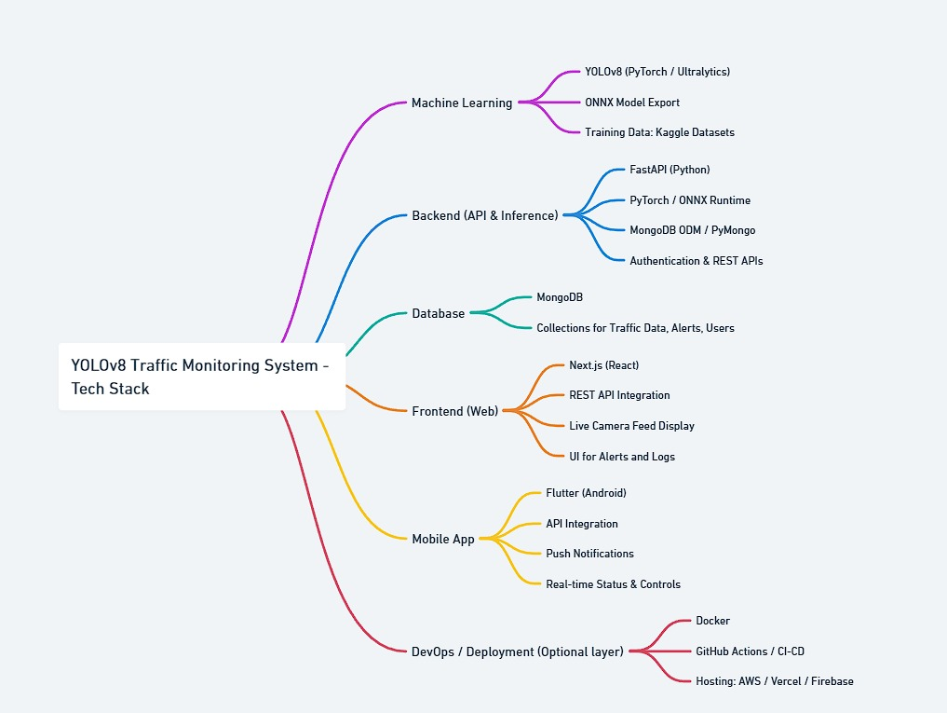

Technical Implementation

Slide 10
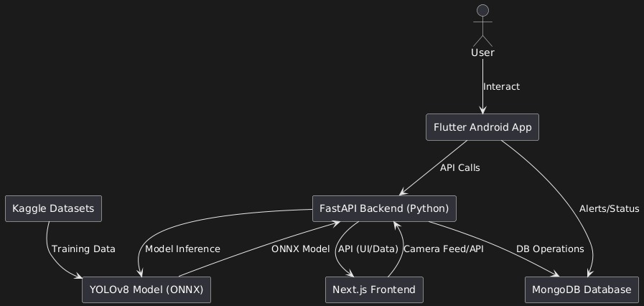


Slide 11
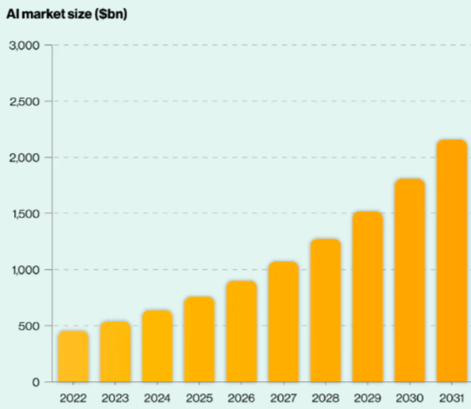
Market Opportunity
$166B
21%
Market Size by 2027
CAGR
Global smart transportation sector growth
Compound annual growth rate
65%
AI Adoption
Cities planning AI traffic solutions

Slide 12
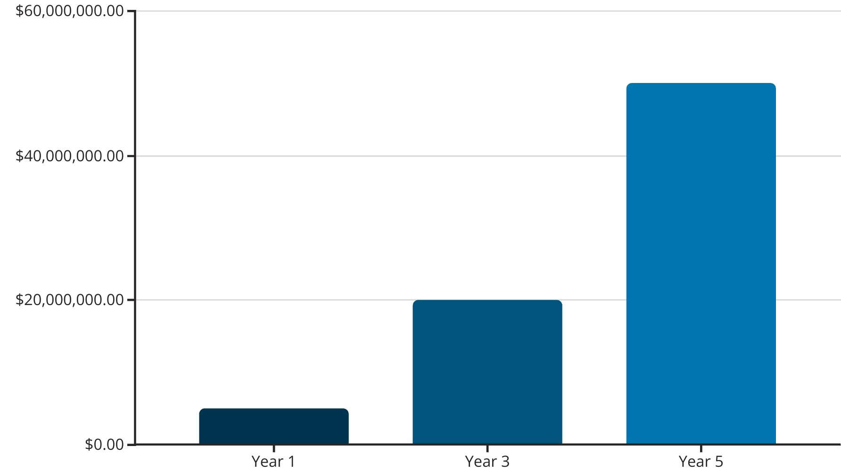
Financial Projections
Expected ROI for investors: 3x within 5 years.
Our solution promises strong financial returns with key partnerships driving adoption.

Slide 13

Challenges faced
1. Ways to prioritize emergency vehicles
2. How to adjust traffic signals dynamically according to real-time traffic flow.

Slide 14




Conclusion
Revolutionize Mobility
Measurable Benefits
Market Growth
Join Us
Positioned for rapid expansion in a growing sector.
Partner with us to build the future of transportation.
Transform how people move through urban environments.
Reduce congestion, emissions, and accidents.

Slide 15

Thank You

